Slide 1
k-Nearest Neighbors (k-NN) Classification / Regression
By Zach Pohlman, Alex Ann, Trent Gregory

Slide 2

Introduction: K-NNs Algorithms
Basic Definition: a supervised machine learning algorithm that classifies a new data point based on the majority class of its 'k' nearest neighbors in the training data.

Slide 3
Algorithm Design

Slide 4
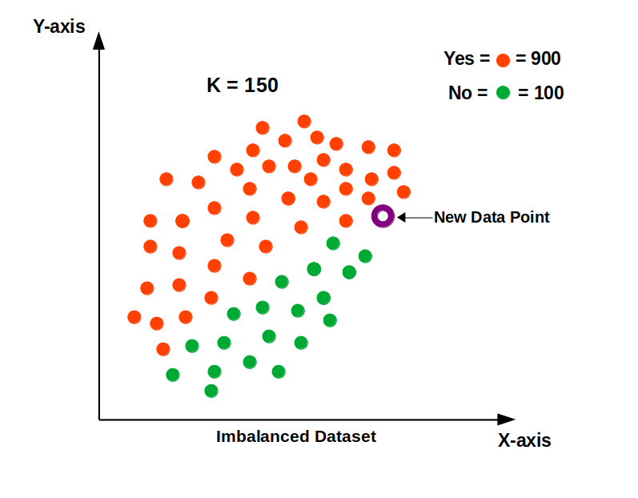
Lazy Learning:
KNN is considered a "lazy" algorithm because it does not construct a model during the training phase.
It memorizes the entire training dataset and performs computations only when a prediction is requested for a new data point.
Due to this, Optimization of datasets are prioritized.

Slide 5
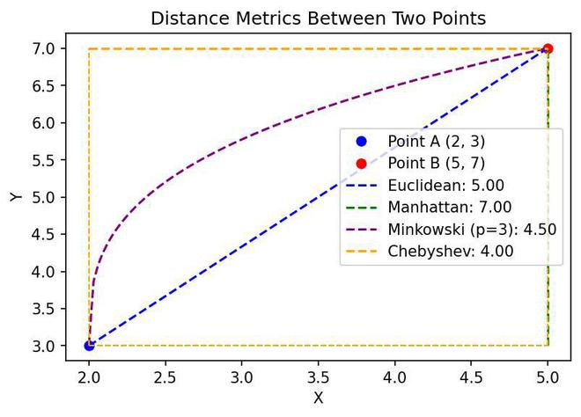
Distance Metrics:
The core of KNN relies on measuring the "distance" or similarity between data points.
Common distance metrics include
  Euclidean distance,
  Manhattan distance,
  Minkowski distance.
The choice of metric can significantly impact performance.

Slide 6
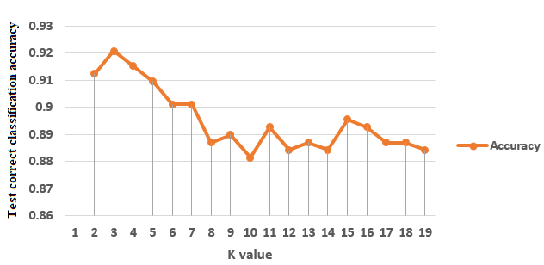
Choosing 'K' Value:
This parameter determines the number of nearest neighbors to consider when making a prediction.
For classification, the new data point is assigned the class that is most frequent among its K nearest neighbors (majority voting).
For regression, the predicted value for the new data point is typically the mean or median of the values of its K nearest neighbors.
Choosing an optimal 'K' is crucial, as too small a 'K' can make the model sensitive to noise, while too large a 'K' can lead to over-smoothing and underfitting. An odd 'K' is often preferred in classification to avoid ties.

Slide 7
Issues

Slide 8
Sensitivity to Feature Scaling and Irrelevant Features:
As the scale of features increases, larger ranges disproportionately influence the distance calculations of KNN.
Feature scaling (e.g., normalization or standardization) is often necessary. Irrelevant features can also degrade performance.

Slide 9
The Data

Slide 10
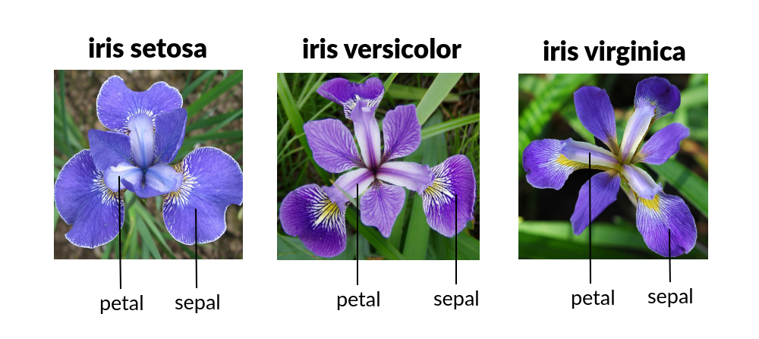
Iris.csv
Widely accessible dataset, mainly used for testing algorithms.
Multiple constraints with one dependent variable.

Slide 11
Diabetes.csv
This dataset is originally gathered from the National Institute of Diabetes and Digestive and Kidney Diseases.
The objective of the dataset is to diagnostically predict whether a patient has diabetes based on certain diagnostic measurements included in the dataset.
From the data set in the (.csv) File We can find several variables, some of them are independent(several medical predictor variables) and only one target dependent variable (Outcome).

Slide 12
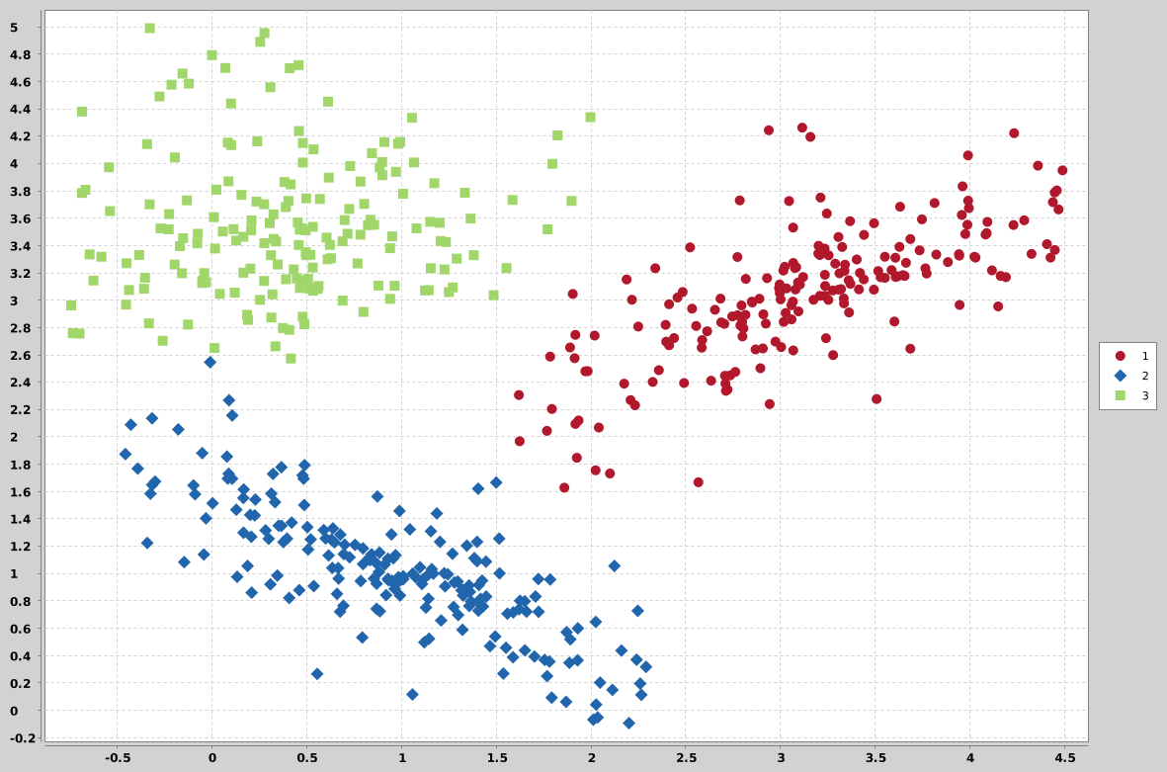
Implementation:
Because of its implementation, its focuses more on regression or classification tasks.

Slide 13
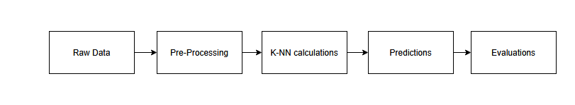
FlowChart

Slide 14
Pre-processing

Slide 15
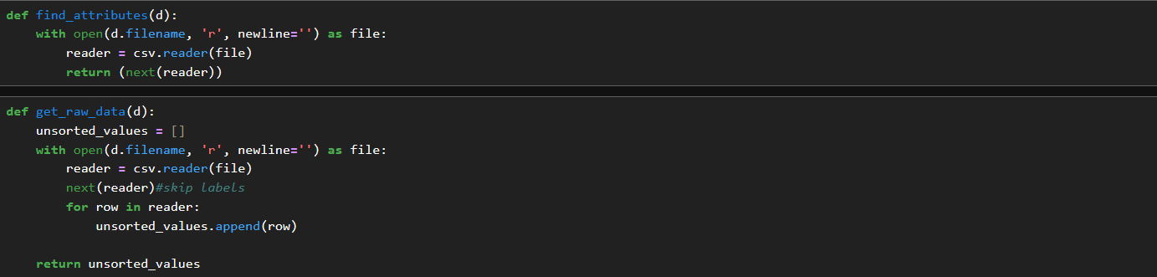
Raw Data
The algorithm first gets the raw data from the file. The data would then get broken down for common attributes. In the data, we have the luxury to having the attributes defined for us.
Because the (factoring) data we would be processing mainly focuses on numbers and integers, there’s no contingency for handling strings outside of a warning.

Slide 16
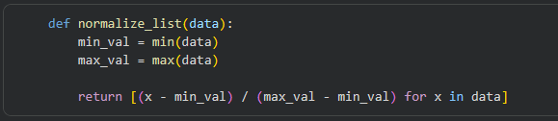
Normalization

Slide 17
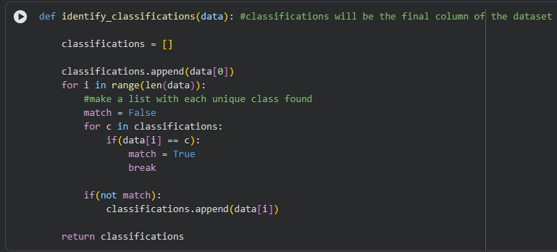
Identifying Classifications

Slide 18
Training Scheme?
As stated, K-NN algorithms don’t necessarily learn from training sets, as it’s a “lazy learner”.
Diabetes and Iris CSV files will be fed into the algorithm, studying for trends among the data to see if there are any trends in information.
  They instead store data and perform the computations at the time of classification.

Slide 19
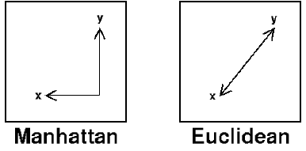
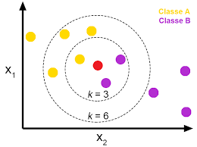
Optimization (Calculations)
Distance Metric:
K-Value

Slide 20
Evaluations

Slide 21
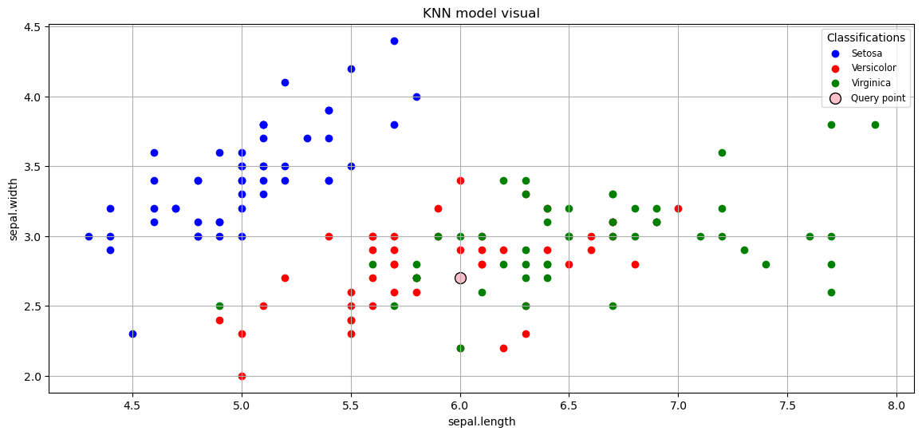
Iris - Evaluations
Results: Incorrect.
model predicted: Virginica
correct value: Versicolor
Ratio of correct model outcomes: 90.0%
Ratio of correct model outcomes: 100.0%

Slide 22

Iris - Evaluations
The datapoint randomly pulled from the set had variety: Versicolor
The closest neighbors identified have indices [85, 50, 64, 76, 75, 51, 74]
The model has classified the point as variety: Versicolor

Slide 23
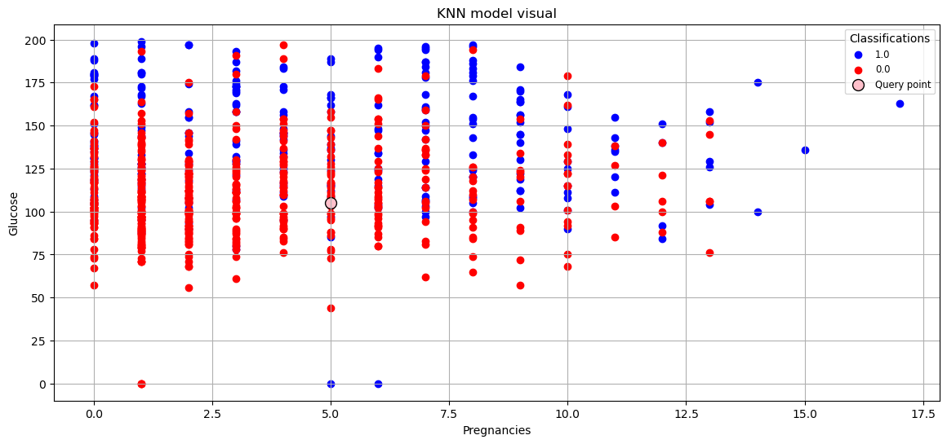
Diabetes - Evaluations
Outcome - 0, 1.
The datapoint randomly pulled from the set had Outcome: 0.0
The model has classified the point as Outcome: 0.0

Slide 24
Any Questions?

Slide 25
Thank you for attending!

